Slide 1

M. Hamza
Employee ID: 5622

Slide 2

What is Angular?
Type-Script Based Framework
A Comprehensive Solution for front end of Single Page Applications (SPAs)
Developed by Google(2010)
New version is released every 6 months
Used for desktop and mobile web applications.

Slide 3

Problem it Solves
Extensive manual code to synchronize data between model and the view.
Dependency management was manual.
Developers relied on multiple third-party tools

Slide 4
Installation and Pre-Reqs
Install npm (Node Package Manager
Install Node.js
Install Angular CLI using npm install -g @angular/cli
Start the server by running: ng serve.
Navigate to http://localhost:4200 in browser to see running Angular application.
Run: ng new my-first-app, In your desired project directory.

Slide 5
String Interpolation
Property Binding
Purpose: Embed expressions in HTML
Syntax: {{ expression }}
Example: <p>{{ title }}</p>
Purpose: Bind component properties to DOM attributes
Syntax: [property]="expression"
Example: <input [value]="username">

Slide 6
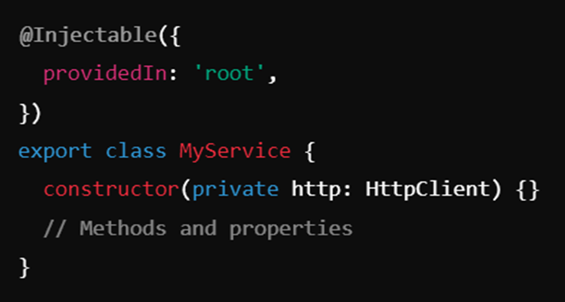
Services
Provide reusable logic and data across components
Manage state, perform HTTP requests, and more
Command: ng generate service service_Name

Slide 7
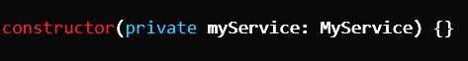
Injecting Services
ProvidedIn: 'root': Singleton service available app-wide
ProvidedIn: 'any': New instance for each lazy-loaded module

Slide 8
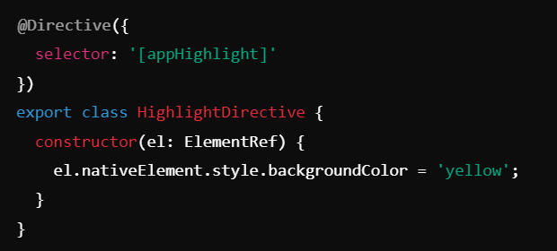
Injecting Services
Modify DOM behavior or appearance
Enhance element and component functionality
Command: ng generate directive directiveName

Slide 9
Types of Directives
Structural Directives
Attribute Directives:
Change Layout: Add /remove elements
*ngIf="condition": Conditionally include/exclude elements
*ngFor="let item of items": Repeat elements
Change Appearance: Style or behavior of elements
[ngClass]="{'active': isActive}": Apply CSS classes
[ngStyle]="{'color': color}": Apply inline styles

Slide 10
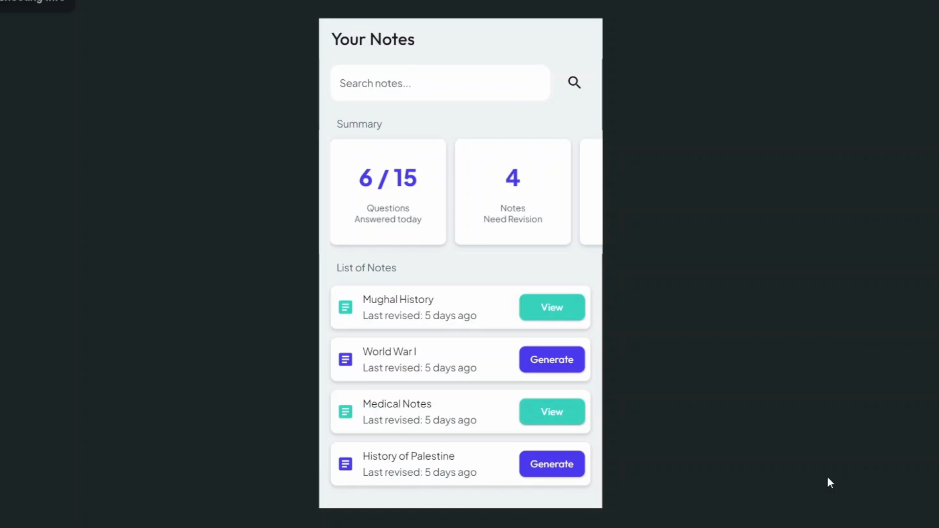
Prototype

Slide 11
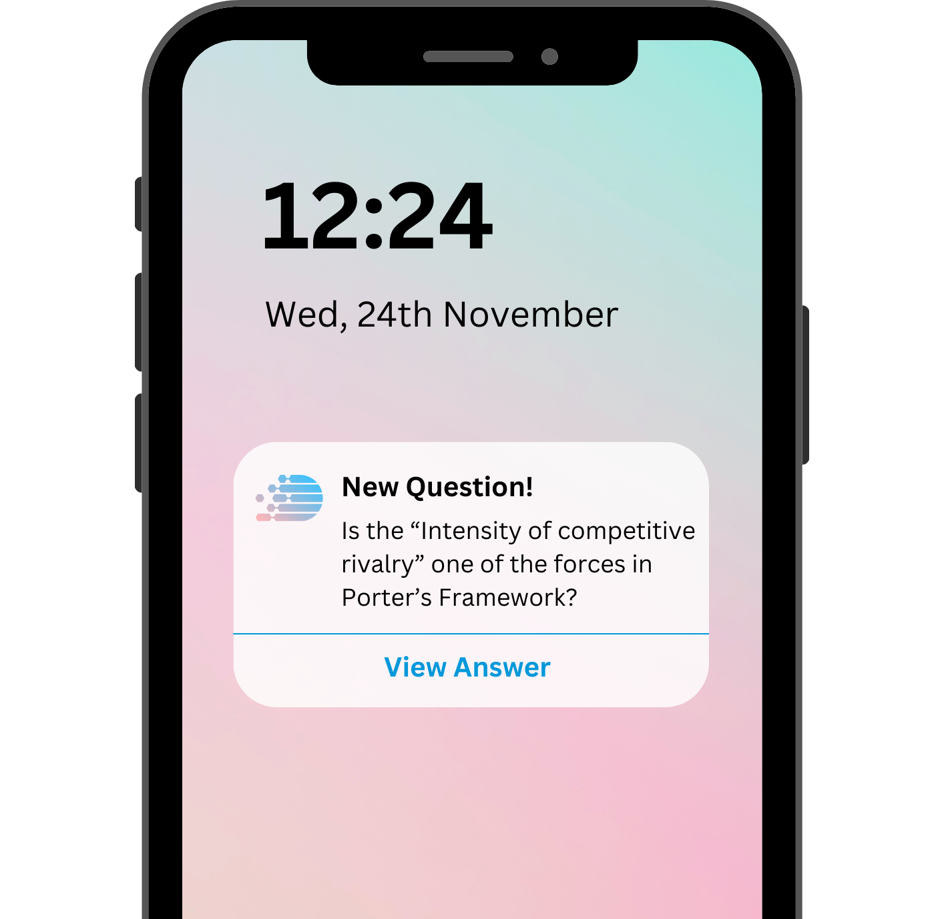
Push Notifications
Get a random question from ReviseMate
Challenge yourself to answer it correctly
View the answer immediately
See if you got it right!

Slide 12
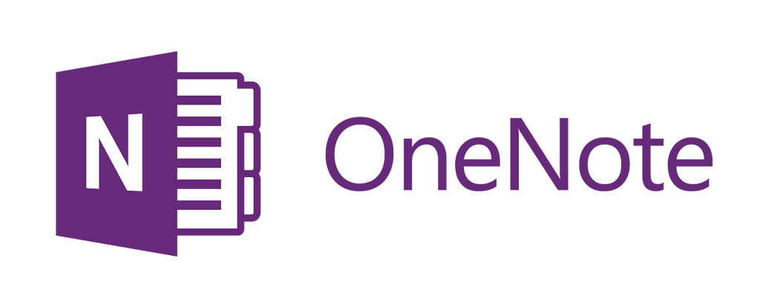

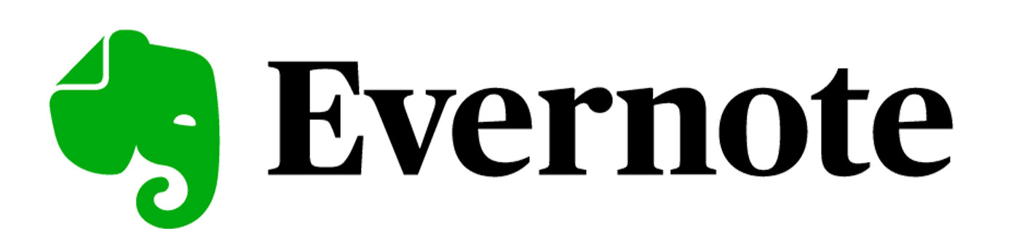
Industry Analysis
225 Million
100 Million
30 Million
Huge Market to tap into
350+ Million Users

Slide 13


Industry Analysis
 | AI Based Questions | Ease of Use for Non-techies | Connects to popular Note Taking Platforms | Push Notifications with Questions
Traditional Revision
Anki
Quizlet
ReviseMate.ai

Slide 14

Unique Selling Point
One-of-a-kind AI based Revision Partner that keeps your knowledge fresh

Slide 15




Team Expertise
Somaan Shakeel
Malik Zain Ali Sajid
M. Ahsan Saleem
Muhammad Hamza
App and Web Development
Software Development & Design
Digital Marketing & Financing
Meta DM. Associate & MS Excel Professional

Slide 16
Pricing Model
$ 0 / Month
$ 4.99 / Month
$ 9.99 / Month
50 questions can be generated per month
Max. 3 Questions asked per day
Can only connect one note-taking platform
500 questions can be generated per month
Max. 10 questions asked per day
Can only connect one note-taking platform
Customer Support
Unlimited question generation per month
Customizable frequency
Can connect multiple note-taking platforms
Customer Support

Slide 17


Financial Evaluation
Starting Cost Play store / Appstore Domain/Hosting App Development | $ 260 ( ~ 75,000 PKR)
Monthly Costs App Dev. Tools Salaries | $ 530 (~ 150,000 PKR)
Yearly Cost App Store Domain/Hosting | $ 200 (56,000 PKR)
Variable Cost Open AI API | $ 0.04 (12 PKR) per 1000 words
Will be profitable in
7 months
Require an Investment of 5 lac PKR

Slide 18
Thank You
Q & A

